Slide 1
INTERVIEW TIPS FOR ENGINEERS
Texts are directly from:
https://www.triad-eng.com/staffing-articles/interview-tips-for-engineers.php#A Recruiter’s Guide to a Successful Engineering Interview
https://www.glassdoor.com/Interview/entry-level-electrical-engineer-interview-questions-SRCH_KO0,31.htm
https://www.slideshare.net/PenelopeCruz789/top-10-electrical-engineer-interview-questions-and-answers

Slide 2
Before Your Interview
Know Your Knowledge, Skills, and Accomplishments
Review your resume carefully
Don’t exaggerate
Don’t miss any important item that you can add to the resume
Make sure that you can discuss each bullet point on your resume (your education, experience, etc.)

Slide 3
Before Your Interview
Prepare Your References
Send the latest version of your resume to all references
Update your references about your accomplishments
Make sure you have secured permission from each reference

Slide 4
Before Your Interview
Research Your Interviewer
Try to learn in advance the names of interviewers,
Their professional background,
Education, and expertise
Interests
Prepare your own questions related to the interviewer's skills/interest or your common interests

Slide 5
Before Your Interview
Learn About Your Potential New Workplace
Research the company
Review their website,
Learn about their achievements / Current Projects
Learn about their key figures
Review their online press releases
Make yourself knowledgeable on company’s background and its current status

Slide 6
Before Your Interview
Review the requirements and skills listed in the employer’s job description
Plan Key Talking Points
Prepare relevant and explicit examples to use during the interview
Plan your answers to common interview questions

Slide 7
Before Your Interview
Practice Answering Questions - OUT LOUD
Consider How You Will Sell Yourself
Sleep well! Hangover can kill the interview!
Keep calm. Meditate before.

Slide 8
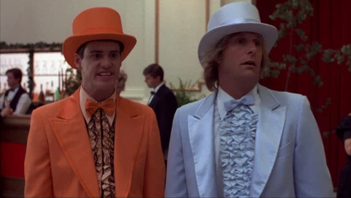
Before Your Interview
Dress Professionally,
but not Too Much!
Don’t Arrive Too Early
Don’t Bring Electronics

Slide 9

Before Your Interview
The first few minutes of any in-person social interaction greatly influences a person’s impression of you, so it is important to present yourself well from the first moment of interaction.

Slide 10
During Your Interview
Sit up straight.
Smile.
Practice appropriate facial expressions.
Practice your handshake.
Watch your gestures.
Don’t fidget
Maintain eye contact.
Maintain your focus on the interviewers.
Take short notes

Slide 11
Interview Questions
General questions
Technical questions
Project-based questions
Problem-solving / behavioral questions

Slide 12
Interview Questions
General questions
About you and your education
Tell me about yourself : Two- to three- minute snapshot of who you are and why you're the best candidate for this position.
Your answer is directly related to the position (in particular) and to the company (in general)

Slide 13
Interview Questions
General questions: Some examples
When and where did you get your electrical engineering degree?
In what classes did you excel? [is it related to this position?]
Where do you see yourself in five years’ time? [Have a plan related to this position (in particular) and to the company, in general]
What is your greatest strength?
Two types of strength:
There are certain strengths that all employers seek in the candidates they hire.
Others will be specific to the job and the company.
[The company wants to learn whether you are a good fit for the role you are interviewing for]
General Rule:
Be Specific
List your skills that match those the employer is seeking. This list can include education or training, soft skills, hard skills, or past work experiences.

Slide 14
What is your greatest weakness? [Turn weakness indirectly to strength, or talk about a weakness not directly related to the job]
I focus too much on the details.
I have trouble saying “no.”
I get impatient when projects run beyond the deadline.
I can have trouble asking for help.
Why should we hire you?
Match your skills/experience/knowledge/enthusiasm/ideas… with the position
What is your greatest accomplishment?
Better be related to the job or your expertise, but not necessarily. In any case be specific
What can we expect from you in your first 90 days?
Will be defined based on the specifications of the job
Do you have any questions? Sure… Study the Job & Company very well
General Rule:
Be Specific

Slide 15
Interview Questions
General Rule:
Be Specific
Technical questions
Sometimes interviewers ask technical questions like an oral engineering exam:
What is a general layout of an Electrical power grid?
What is arc flash analysis?
What does a transistor do?
Can you explain Norton's Theorem in a single sentence?
What are the three most common types of cable for transmitting power?
What electrical engineering computer software are you familiar with?
Project Management Questions

Slide 16
Interview Questions
Project-based questions
What projects have you worked on?
What was your position?
Were you the project lead or subject matter expert?
What was the end result?
What did you accomplish?
Explain about one of your projects which is failed?
Tell me about an experience in which you analyzed information and evaluated results to choose the best solution to a problem.
General Rule:
Be Specific

Slide 17
Interview Questions
General Rule:
Be Specific
Problem-solving / behavioral questions
Your interviewer simply wants to gain a sense of how you think, and observe how you communicate your answer.
How would you approach this problem…”
What major challenges and problems did you face? How did you handle them?
Describe the most challenging written technical report or presentation that you’ve had to complete.
What checks and balances do you use to make sure that you don’t make mistakes?
On your last project assignment, what problems did you identify that had been previously overlooked?

Slide 18
Interview Questions
Problem-solving / behavioral questions
Your interviewer simply wants to gain a sense of how you think, and observe how you communicate your answer.
How do you deal with conflict? Do you avoid it or face it?
what do you think are the best techniques to deal with conflicts at any time?
What did you like or dislike about your previous job?
What are the most difficult decisions to make?
THINK LIKE AN ENGINEER

Slide 19
https://www.vawizard.org/wiz-pdf/STAR_Method_Interviews.pdf

Slide 20
General Rule:
Be Specific
SAMPLE BEHAVIORAL INTERVIEW QUESTIONS
Practice using the STAR Method on these common behavioral interviewing questions:
• Give me a specific example of a time when you used good judgment and logic in solving a problem.
• Give me an example of a time when you set a goal and were able to meet or achieve it.
• Tell me about a time when you had to use your presentation skills to influence someone's opinion.
• Give me a specific example of a time when you had to conform to a policy with which you did not agree.
• Please discuss an important written document you were required to complete.
• Tell me about a time when you had to go above and beyond the call of duty in order to get a job done.
• Tell me about a time when you had too many things to do and you were required to prioritize your tasks.
https://www.vawizard.org/wiz-pdf/STAR_Method_Interviews.pdf

Slide 21
During your Interview
Shake hands with your interviewer(s)
First impressions should convey trustworthiness and competence
Take time to collect your thoughts
Don’t Talk too much
Don’t be monotonous / Avoid filler words (Um, Ah, And you know…)
Avoid “Do you what I mean…?”
Have eye contact, manage your body language
Take notes
Think about possible questions
Bring extra resume

Slide 22
During your Interview
It’s OK to say, I don’t know
Be specific about your contributions and results
Be honest and positive
Ask questions
Ask about any concern regarding your qualifications
Don’t ask about compensation and benefits
Don’t exaggerate
Don’t speak negatively about prior managers or colleagues
Sit and behave professionally

Slide 23
During your Interview
If you are sitting when someone approaches you, stand up before you shake their hand. Look them in the eyes and smile.
Offer a greeting like, “It’s nice to meet you…” and say their name. You’ll be more likely to remember their name if you say it out loud when you first meet.

Slide 24
How to sit during an interview
Sit at the back of the chair.
Lean forward.
Keep both feet on the ground.
Tilt your head. Lean your head slightly to one side at times to appear friendly and interested in what the interviewer is saying.
Make eye contact.
Nod.
Control your hands. Avoid distracting or nervous actions such as touching your face or hair and defensive actions such as crossing your arms.
Restrain nervous habits.
Respect personal space.

Slide 25
During your Interview
Practice polite, confident body language
While you’re waiting for your interviewers, sit with your back straight and shoulders open. Hands can rest on your lap or armrests.
Always have a napkins in your pocket
Do not check the time back to back but consider the allocated time for the interview

Slide 26
During your Interview
Some interviews may be conducted over a meal. All the basics of how to be polite at the table apply here:
If your meal arrives first, wait to eat until others have received their food as well.
Place your napkin in your lap.
Don’t talk with food in your mouth.
Take small, manageable bites.
It’s best to not drink alcoholic beverages during an interview. If your interviewer orders alcohol, use your best judgment and stay within your comfort zone. You can always opt for a seltzer or soft drink.

Slide 27
After your Interview
Thank Your Interviewer
Reflect on the Conversation
Send a thank you note after the interview, within 24 hours.
And Wait!

Slide 28
Interview Tips for Entry-Level Electrical Engineers
How to stand out and succeed
Know Your Fundamentals
Review circuits, signals, power basics
Examples:
Be ready to explain Ohm’s Law in real systems
Explain Thevenin's Theorem in two sentences.
Why do we care about it in the context of input and output impedance?
AC vs. DC Applications: "Why do we use AC for long-distance power transmission instead of DC?
Why does a capacitor block DC but allow AC to pass?
The Troubleshooting Walkthrough
Prepare for Technical Tests

Slide 29
Understand the Job Description
Interview Tips for Entry-Level Electrical Engineers
Match your skills to role
Example: If job mentions PLCs, prepare one project using PLC
Know details deeply
Example: Explain design decisions, challenges, results

Slide 30
Practice Common Questions
Interview Tips for Entry-Level Electrical Engineers
Why this company?
Tell me about a project
Avoid jargon overload
xample: Explain transformer to a non-engineer

Slide 31
Demonstrate Problem Solving
Interview Tips for Entry-Level Electrical Engineers
Think clearly during questions
Example: Circuit troubleshooting steps
Use the STAR Method
Situation, Task, Action, Result
Example: Describe capstone clearly

Slide 32
Behavioral Questions Matter
Interview Tips for Entry-Level Electrical Engineers
Teamwork, leadership
Example: Conflict resolution in group project

Slide 33
Ask Good Questions
Interview Tips for Entry-Level Electrical Engineers
Study the company and the job
About team, tools, projects
Example: What software tools are used?

Slide 34
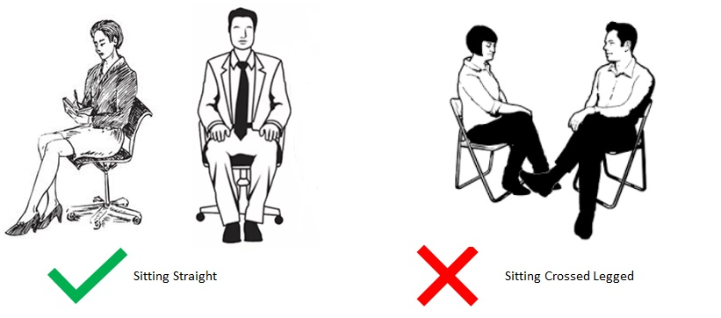

Body Language & Communication
Interview Tips for Entry-Level Electrical Engineers
Eye contact, clarity, confidence

Slide 35
Follow-Up After Interview
Send thank-you email within 24 hours
Final Advice
Be honest, prepared, and confident

